Slide 1
Introduction of Python Programming
Anuj Kumar Jain
anujkumarjaingit@outlook.com

Slide 2
Python
Python is a simple, easy to learn, powerful, high level and object-oriented programming language.
Python is an interpreted scripting language also.
In 1991, Guido Van Rossum is known as the founder of python programming.

Slide 3
Feature Python Programming
Easy to learn and use language
Large standard library
Runs anywhere.
free and open Source software.
Strongly and dynamically typed
Object-oriented programming.
Modules and packages
Automatic memory management and Manually management
Extensible in C++ & C

Slide 4
Limitation of Python
Difficulty in Using Other Languages
Weak in Mobile Computing
Gets Slow in Speed
Run-time Errors
Underdeveloped Database Access Layers

Slide 5
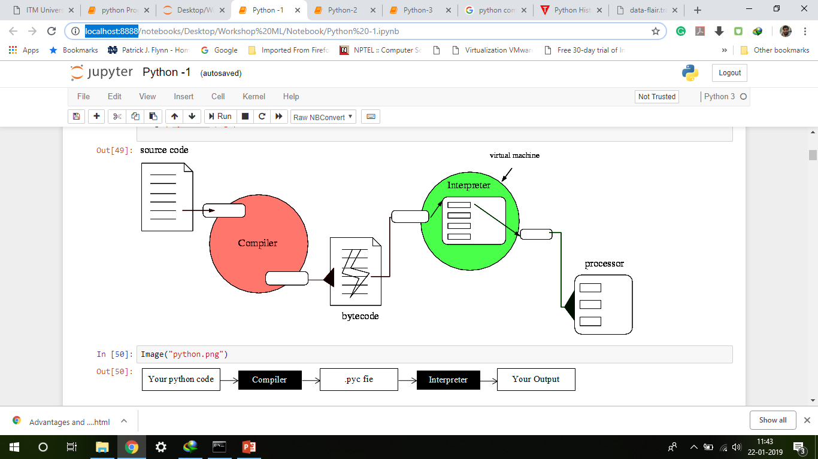
Python Compilation

Slide 6
Variable
Variables are nothing but reserved memory locations to store values.
Python variables do not need explicit declaration to reserve memory space.
The declaration happens automatically when you assign a value to a variable.
The equal sign (=) is used to assign values to variables.

Slide 7
Data Types
Numeric
String
List
Tuple
Set
Dictionary

